Slide 1
Lec 5
SLIs, SLOs, SLAs

Slide 2
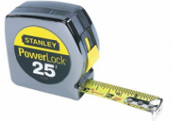
Measuring Reliability and Performance
Distributed systems:
Improve performance
Improve reliability
Or do they? Need to measure to know.

Slide 3
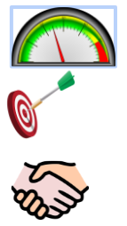
SLIs, SLOs, SLAs,
SLI = Service Level Indicator ⇒ What you are measuring
SLO = Service Level Objective ⇒ How good should it be?
SLA = Service Level Agreement ⇒ SLO + consequences

Slide 4
Why study SLIs, SLOs, and SLAs?
If you measure it, you can improve it
Learn what matters
Don’t waste time on things that don’t matter!
Reliability promises are part of business

Slide 5
Reading an SLA
I promise 99% uptime”
How often do you check if your system is up?
Sampling frequency
What does it mean to be “up”?
Domain of responsibility
Over what time interval do you promise 99% uptime?
Measurement interval

Slide 6
How many nines?
Nines | Uptime | Downtime/month
1 | 90% | 3 days
2 | 99% | 7 hours
3 | 99.9% | 43 minutes
4 | 99.99% | 4 minutes
5 | 99.999% | 25 seconds (5m/year)

Slide 7
Cloud VM providers
Consider Microsoft Azure, Amazon EC2, Google GCE
Promise 99.95% uptime (22 minutes downtime/month)
Better than our net connection… right?
1-minute sampling frequency
GCE doesn’t count <5 minute outages

Slide 8
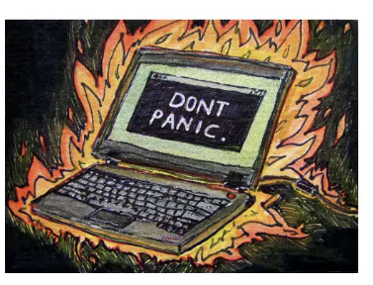
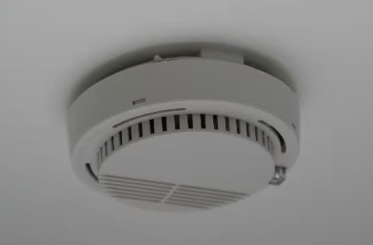

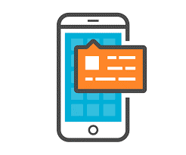
What does the SLA imply for provider?
99.95% (or 22 minutes/month downtime) means either:
They rarely expect their hardware or software to fail
When it fails they think they can fix it quickly

Slide 9
What does the SLA imply for you?
SLA requires you to have:
Multiple VMs
Over multiple failure domains (Availability Zones)
Monitoring
Tolerance of planned outages
Automatic machine provisioning (GCE)

Slide 10
SLA: contract, or marketing?
Few people read SLA in detail until failure has happened
In a competitive business, customer loss is worse than a SLA violation
Refund levels tell you what disasters are anticipated
Credits likely won’t cover your losses

Slide 11
Setting your SLO
SLO != SLA
Different applications have different requirements
Know your application
Be conservative at first, gain experience
SLO > reaction time
Do you have 24/7 support?
Know SLA of your dependencies
Bound your responsibility ( Contrast to End to End Principle )

Slide 12
Should you exceed your SLO?
You should try
This gives you operational headroom
Don’t suppress innovation
Change can be good
Don’t set Implicit SLA

Slide 13
Composing SLAs
No redundancy:
P(outage) > P(dependencies having an outage)
With redundancy:
P(outage) > P(outage of each replica)

Slide 14
Conclusion
Don’t confuse SLI, SLO, and SLA
If you measure it, you (hopefully) can improve it
Under promise, over deliver
Nothing beats experience

Slide 15
Availability = 1-(Total Down Time / Total agreed expected uptime) * 100
Agreed service time is the expected time the service will be in operation. If your service level specifies that users must have access to an ERP system from 6:00 AM to Midnight on workdays, your agreed service time is 18 hours/1,080 minutes/64,800 seconds per workday.
Downtime is the amount of time during the agreed service time that the service is not available.

Slide 16
Problem
Suppose a cloud guarantees service availability of 99 % of time. Let third party application runs in the cloud for 12 hours / day. At the end of one month it was found that there is a outage often 10.75 hours. Find out whether the provider has violated the initial availability guarantee.

Slide 17
Consider a scenario where a company X wants to use a cloud service from a provider P. The service level agreement (SLA) guarantees negotiated between the two parties prior to initiating business are as follows:
• Availability guarantee: 99.95% time over the service period
• Service period: 30 days
• Maximum service hours per day: 12 hours
• Cost: $50 per day
Service credits are awarded to customers if availability guarantees are not satisfied. Monthly connectivity uptime service level are given as:
Monthly Uptime Percentage Service Credit
<99.95% 10%
<99% 25%
However, in reality it was found that over the service period, the cloud service suffered five outages of durations: 5 hrs, 30 mins, 1 hr 30 mins, 15 mins, and 2 hrs 25 mins, each on different days, due to which normal service guarantees were violated. If SLA negotiations are honored, compute the effective cost payable towards buying the cloud service.

Slide 18
Recap
Service Level Indicator(SLI), Service Level Object(SLO) & Service Level Agreement(SLA) are parameters with which reliability, availability and performance of the service are measured.

Slide 19
Service Level Indicator
SLI are the parameters which indicates the successful transactions, requests served by the service over the predefined intervals of time. These parameters allows to measure much required performance and availability of the service. Measuring these parameters also enables to improve them gradually.
Key Examples are:
Availability/Uptime of the service.
Number of successful transactions/requests.
Consistency and durability of the data.

Slide 20
Service Level Objective
SLO defines the acceptable downtime of the service. For multiple components of the service, there can be different parameters which defines the acceptable downtime. It is common pattern to start with low SLO and gradually increase it.
Key Examples are:
Durability of disks should be 99.9%.
Availability of service should be 99.95%
Service should successfully serve 99.999% requests/transactions.

Slide 21
Service Level Agreement
SLA defines the penalty that service provider should pay in an event of service unavailability for pre-defined period of time. Service provider should clearly define the failure factors for which they will be accountable(Domain of responsibility)
Key Examples of Penalty are:
Partial refund of service subscription fee.
Additional subscription time added for free.

